Slide 1
FireAlpaca Work
Name:

Slide 2
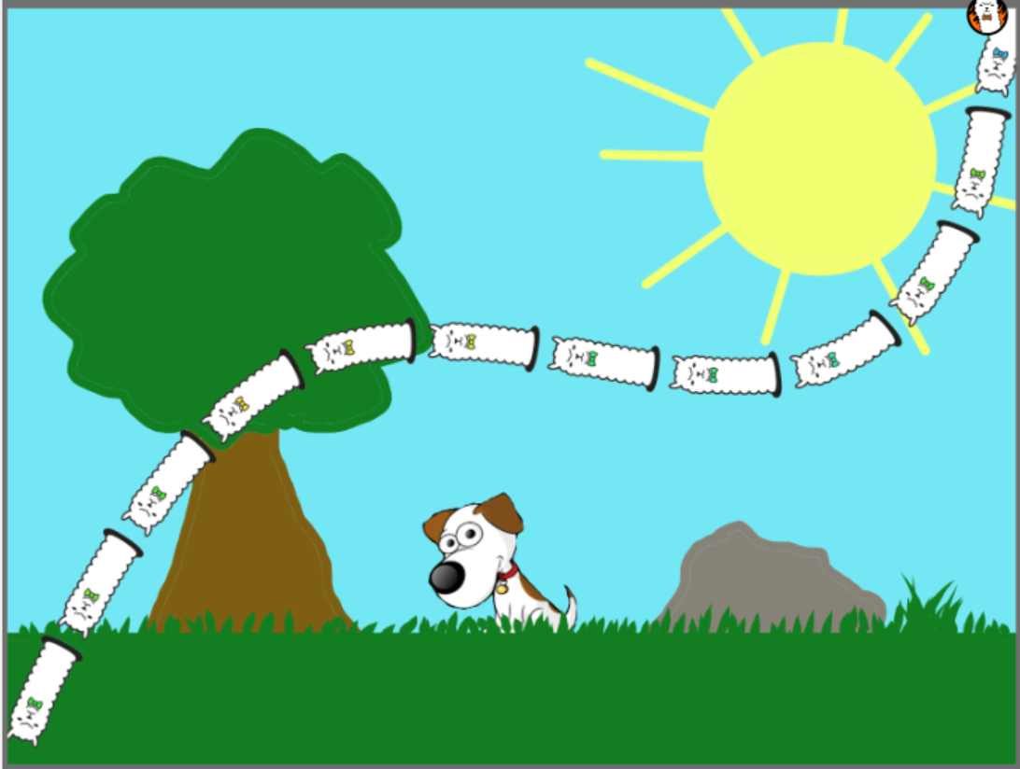
Kindergarten Pic 10pts

Slide 3
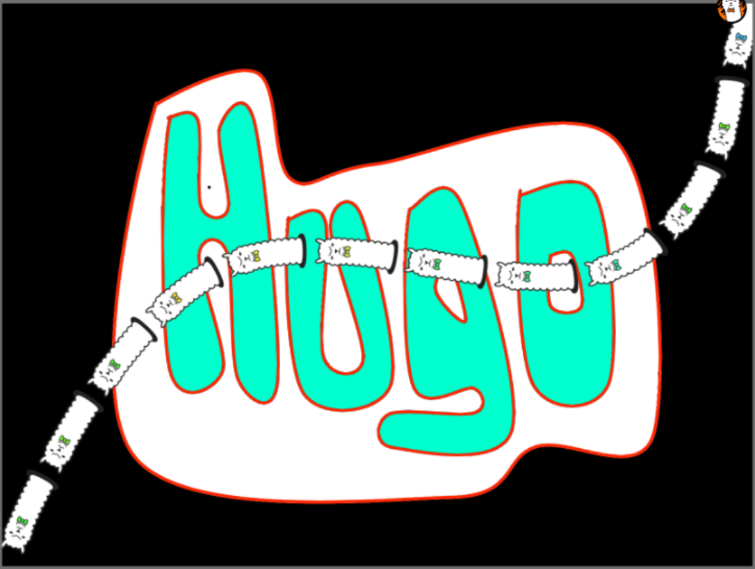
Your Name Written in a cool way --5pts

Slide 4
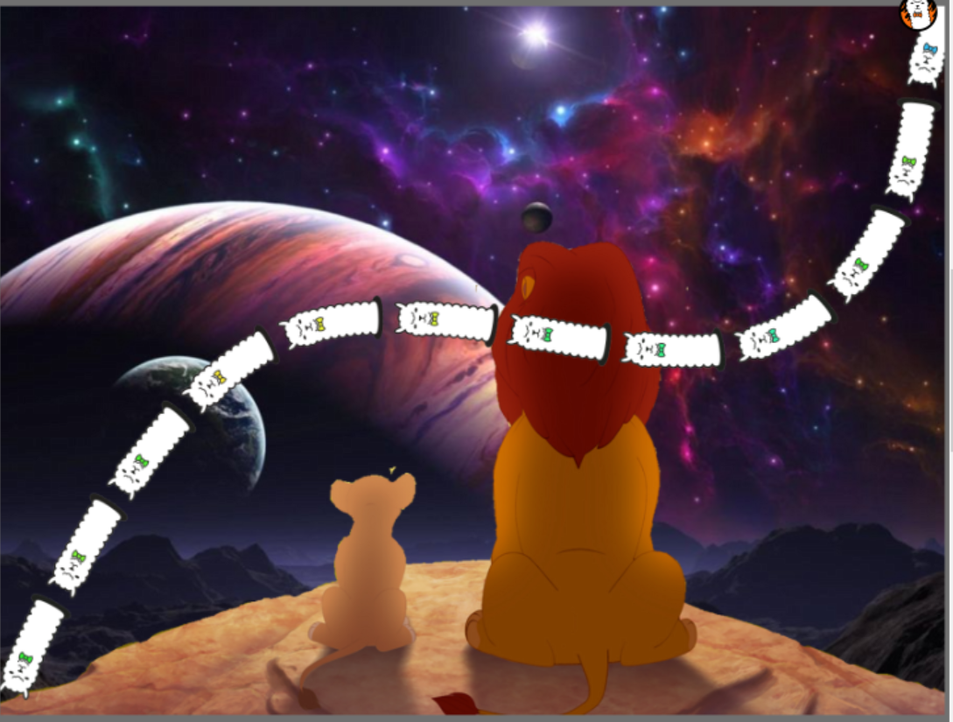
“Photoshopped” picture 5pts

Slide 5
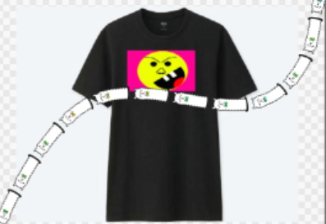
Smiley Shirt Design 10pts

Slide 6
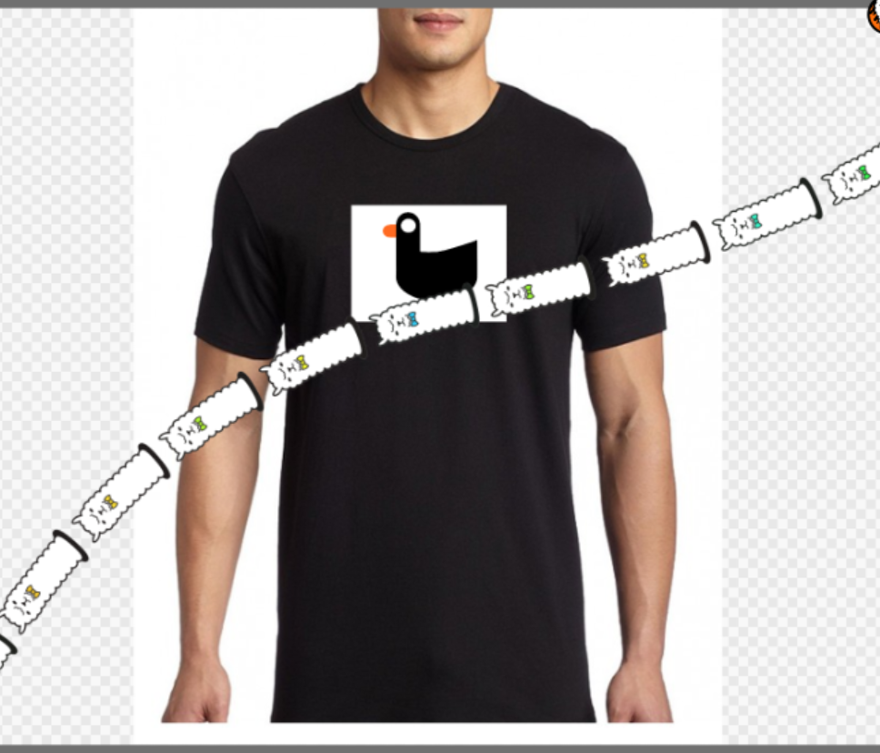
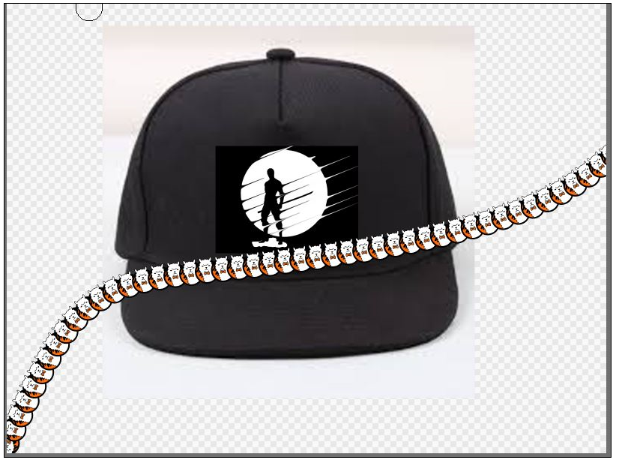
Two (2) T-Shirt Designs--20pts

