Slide 1
Attribution Practice PPT
Name:
Period:
Date:

Slide 2
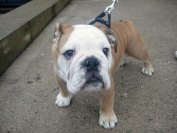
EX.
Name of Picture: Bulldog Puppy
Name of Creator: waldopepper
Source/Website: Flickr.com
CC Commons License: CC BY-NC 2.0
Bulldog Puppy by waldopepper from Flickr.com. CC BY-NC 2.0

Slide 3
1.
Name of Picture:
Name of Creator:
Source/Website:
CC Commons License:

Slide 4
2.
Name of Picture:
Name of Creator:
Source/Website:
CC Commons License:

Slide 5
3.
Name of Picture:
Name of Creator:
Source/Website:
CC Commons License:

Slide 6
4.
Name of Picture:
Name of Creator:
Source/Website:
CC Commons License:

Slide 7
5.
Name of Picture:
Name of Creator:
Source/Website:
CC Commons License:

